Slide 1
Flot
Plotting with JavaScript

Slide 2
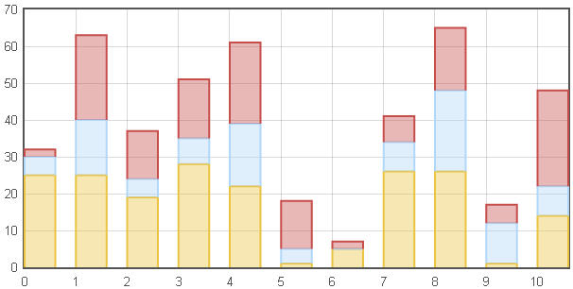
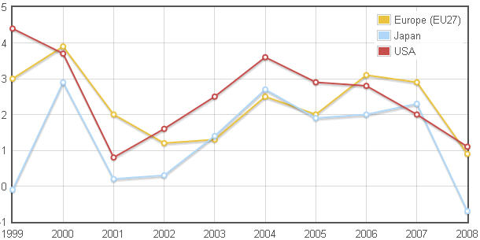
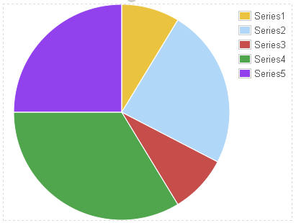
What is Flot?
Flot is a JavaScript plotting library for jQuery
  includes various types of graphs & charts – bar, line, pie

Slide 3
The Flot Library
Flot library can be downloaded from http://code.google.com/p/flot/
  Flot library requires minimum of jQuery 1.2.6, works best with 1.3.2 & above
The JavaScript file – jquery.flot.min.js, is the base file that should be included for Flot to work
  there are other plug-in files in the library that provide enhanced functionality
Flot uses the HTML5 <canvas> element to plot
  IE 8 & below do not support the <canvas> element, hence the JavaScript file excanvas.min.js should be included

Slide 4
Using Flot
Include the JavaScript file – jquery.flot.min.js, after including jQuery library
  usually in the <head> section
  include excanvas.min.js for IE8 & below
  <script type="text/javascript" src="jquery-1.7.1.js"></script>
  <!--[if lte IE8]>
  <script type="text/javascript" src="flot/excanvas.min.js"></script>
  <![endif]-->
  <script type="text/javascript" src="flot/jquery.flot.min.js"></script>
  </head>

Slide 5
Using Flot…
Add an empty placeholder <div> element in the body element of your html
  <div id="placeholder" style="width:500px; height:300px;"></div>
In JavaScript, create series of data array to plot:
  a series is an array that consist of arrays of x & y points:
  var series1 = [[1, 100], [2, 213], [3, 121], [4, 256]];
  var series2 = [[1, 170], [2, 102], [3, 201], [4, 206]];
  var data = [series1, series2];

Slide 6
Using Flot…
The syntax for Flot is:
  $.plot(placeholder, data, options];
  placeholder is the target HTML element within which to plot
  data is the array of data series to plot
  options is the list of configuration parameters like color, lines, bars, etc. Options is an optional parameter
Call the plot function to plot on the page:
  // go plot
  $.plot($("#placeholder"), data);

Slide 7
Formatting
Each data series can be further formatted with more options:
color: specified like "rgb(255, 100, 123)" or an integer that specifies the auto-generated colors to select
label: the label is used for the legend, if not specified, the series will not show up in the legend
lines: by default set to true and draws line chart. Has further options like:
  show: boolean
  lineWidth: number
bars: when set to true, draws bar graph. Has further options like:
  show: boolean
  barWidth: number
points: places points. Has further options like:
  show: boolean
  radius: number

Slide 8
Formatting Example
$(document).ready(function(){
var data = [
{ // series1
label: "Prod1",
data: [[1, 100], [2, 213], [3, 121], [4, 256]],
bars: {show: true},
lines: {show: true},
color: "rgb(255, 0, 0)"
},
{ // series2
label: "Prod2",
data: [[1, 170], [2, 102], [3, 201], [4, 206]],
color: "rgb(0,0,255)",
bars: {show: false},
lines: {show: true},
points: {show: true, radius: 5}
}
];

Slide 9
Options
The formatting options can be applied globally too
  by creating a property map and then passing that as the 3rd parameter to the plot function:
  var options = {
  lines: {show: true, lineWidth:5},
  points: {show: true}
  };
  var plotarea = $("#placeholder");
  $.plot(plotarea, data, options);

Slide 10
Pie Charts
To create pie charts, include jquery.flot.pie.js
  after including jQuery & flot
Create data series:
  // data
  var data = [
  { label: "Series1", data: 10},
  { label: "Series2", data: 30},
  { label: "Series3", data: 90},
  { label: "Series4", data: 70},
  { label: "Series5", data: 80},
  { label: "Series6", data: 110}
  ];

Slide 11
Pie Charts…
Configure options to plot it as a pie:
  // set options, with series: pie property
  var options = {
  series: {
  pie: {
  show: true,
  label: {show:true}
  }
  }
  };
  var plotarea = $("#placeholder");
  $.plot(plotarea, data, options);

Slide 12
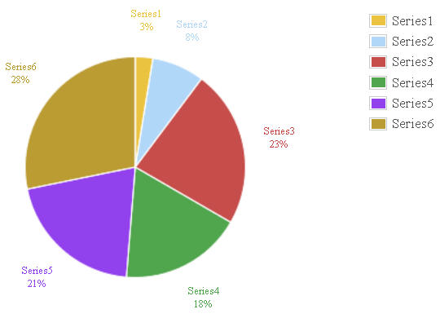
Pie Chart…

